Slide 1
An Analysis of EVs on the Market
BITS Datathon 2022 Busch Consulting Group Joann Lariza, Anish Gupta, Yingfan He

Slide 2
Introduction
Electric Vehicles (EVs) have seen a huge increase in popularity over the past years as consumers and companies have opted for battery-powered vehicles that generate less emission and greater fuel savings compared to their gas-powered counterparts. Recent events such as the surge in gas prices have also led to an increase in demand for EVs.
EV Market Value in the US was $24.03 billion in 2020 (Fortune Business Insights)
Global Electric Vehicle Market Value Projected To Reach $802 Billion By 2027 (Bloomberg)
Avg gas price in the US recently hit an all time high of $4.331 per gallon on 3/11/22 (AAA)

Slide 3
Objective
As part of our research, we wanted to focus on the aspects that would be of most benefit to an average customer.
Which car has the fastest 0-60 acceleration?
Which has the highest efficiency?
Which manufacturer has the most number of vehicles?
What is the relationship between efficiency and price?
What is the relationship between top speed and price?

Slide 4
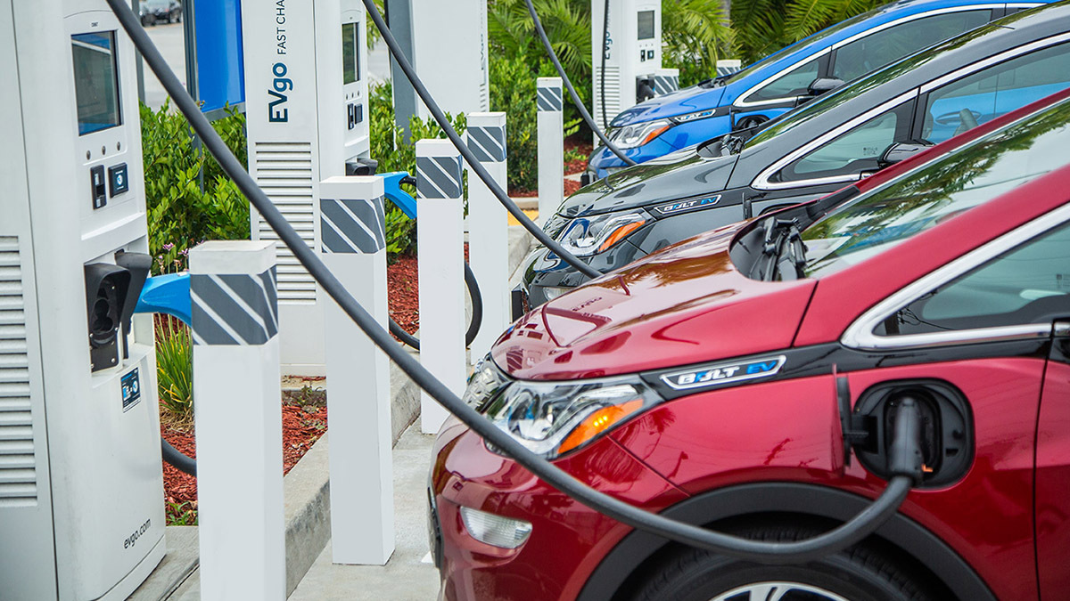
Our findings

Slide 5
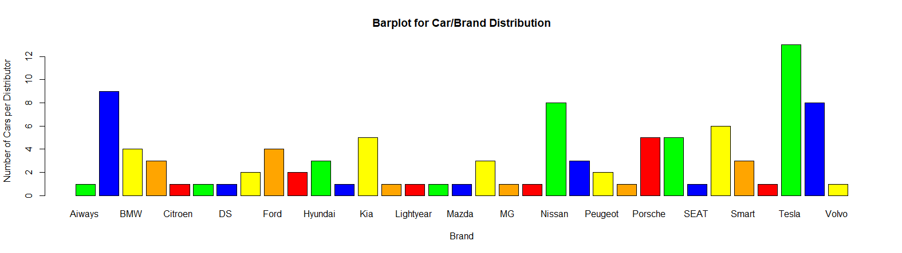

Which manufacturer has the most cars?
Tesla leads the market with the most cars (13), followed by Audi (9) and Volkswagen (8)
This provides the most variety for potential customers

Slide 6
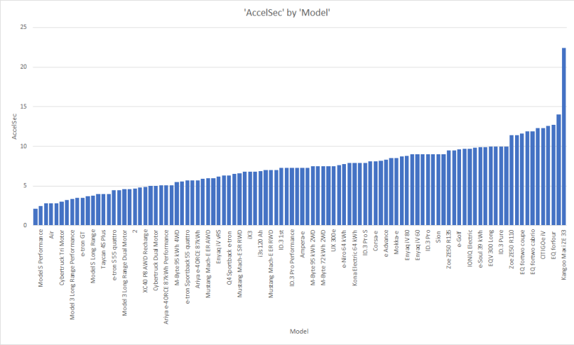
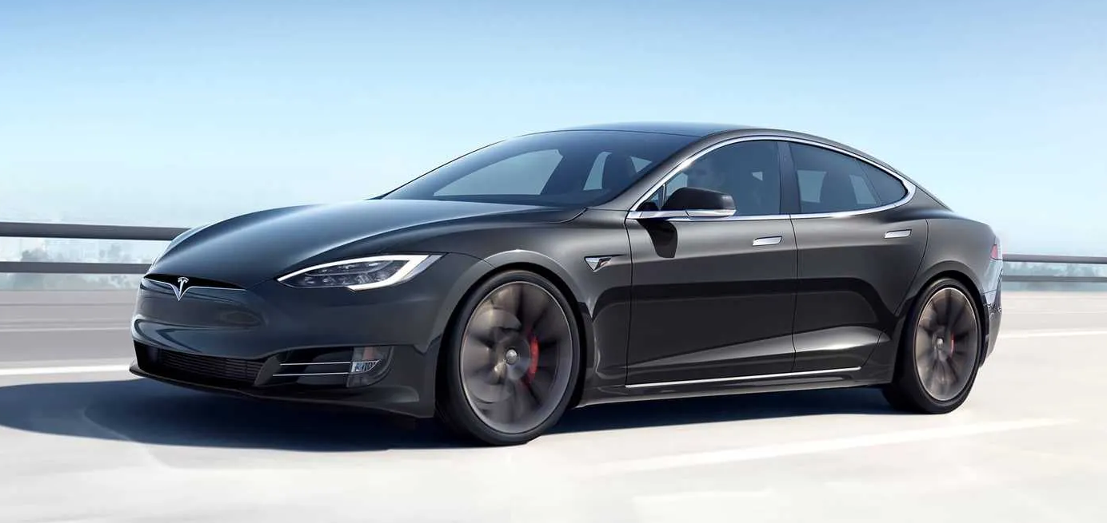
Which car has the fastest 0-60 mph acceleration?
The Model S performance (Tesla) has the fastest acceleration of all the models reviewed, coming in at a speed of 2.5 secs.
Higher acceleration rates provide easier transitions when merging onto highways and intersections

Slide 7
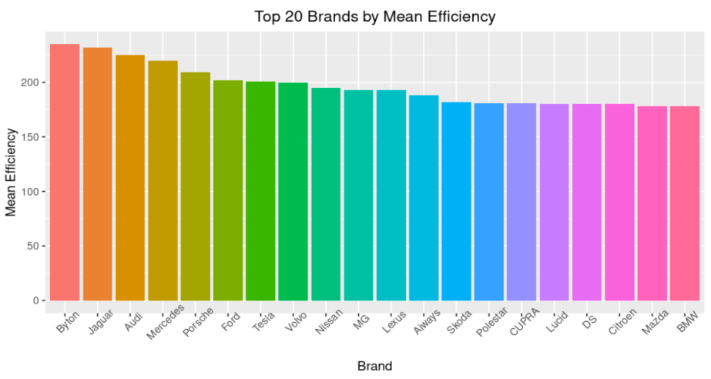

Which car has the highest efficiency?
Cars from Byton have the highest efficiency of cars on the market.
*Note that this graph contains the average of all models for each brand.
High efficiency means drivers can travel more miles per kilowatt hour

Slide 8
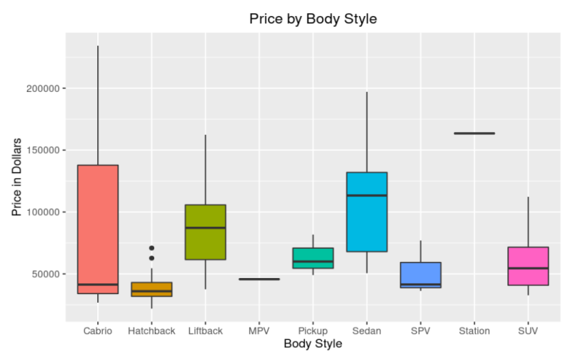
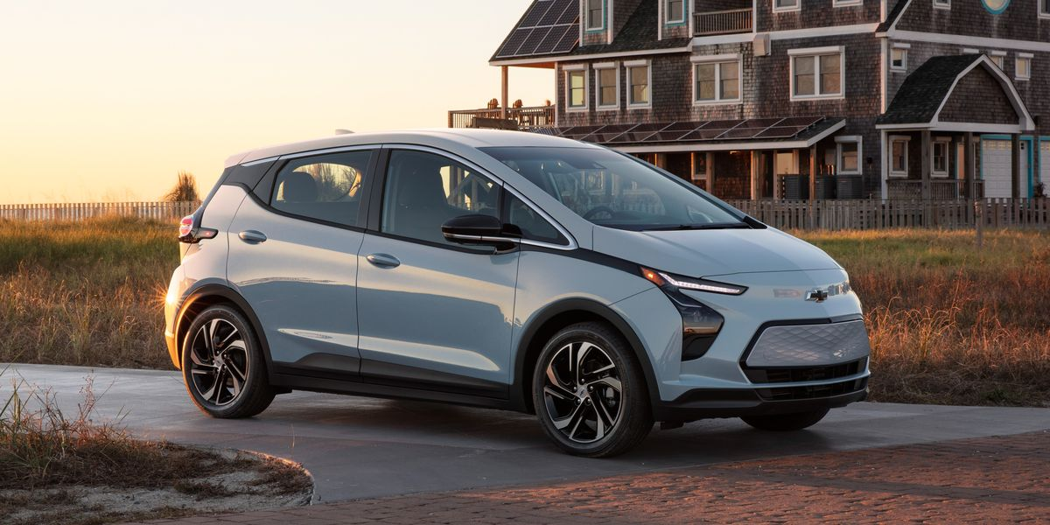
Price by body style
Hatchbacks have the lowest median price amongst all the difference body styles.
Hatchbacks offer more space than typical sedans

Slide 9
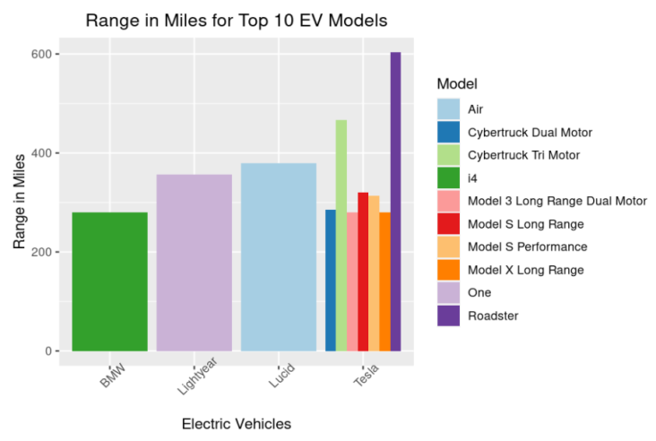
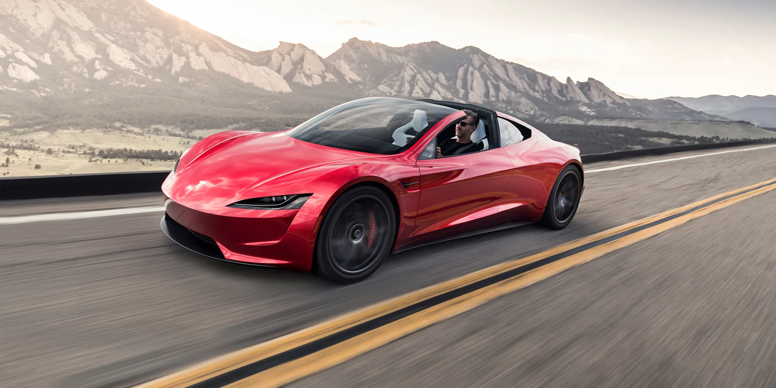
Top 10 Models
The Tesla Roadster has the largest range for an EV on the market, coming in at 603 miles

Slide 10
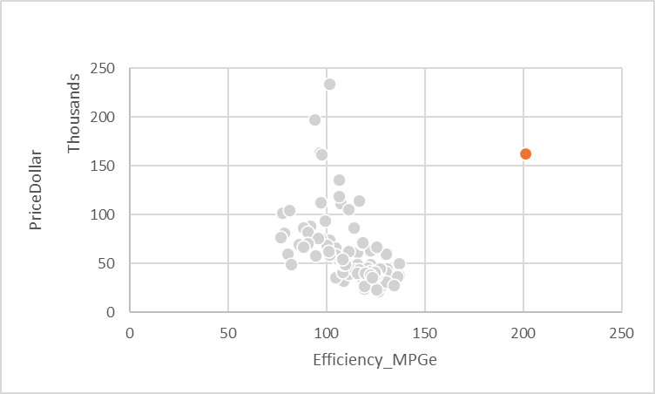
Relationship between efficiency and price
Efficiency and Price appear to form a cluster with 1 outlier.
To obtain an average of 100-150 MPGe, customers will have to spend around $50-$75,000

Slide 11
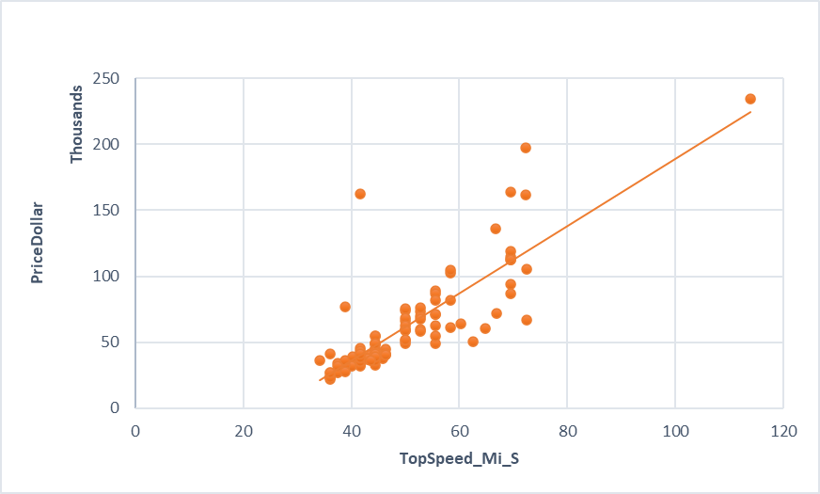
Relationship between top speed and price
Top speed and Price appear highly correlated with 2 outliers.
For drivers to have an average of 60-80 miles (as top speed), they will have to spend around $50-100,000

Slide 12
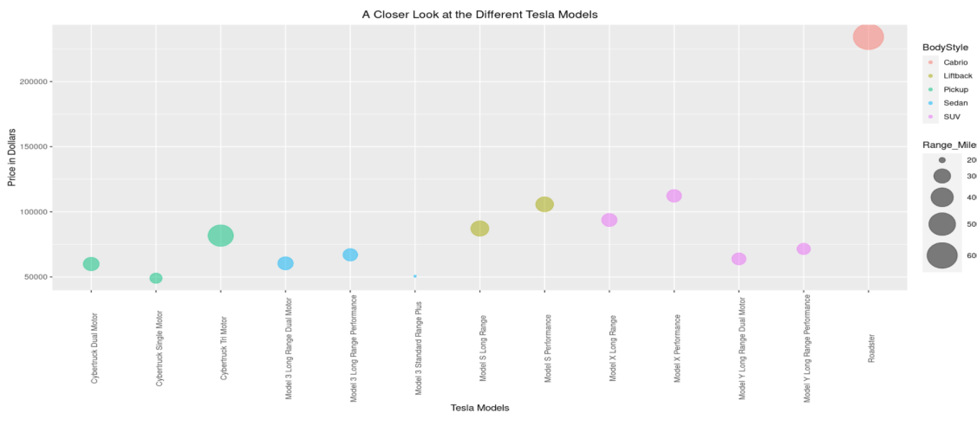
Looking at one of the most popular EV brands on the market

Slide 13
Conclusion
The Tesla Roadster would be suitable for consumers that travel a lot. The whopping range of 603 miles per charge makes it a great choice for long distance road trips.
We recommend Byton cars for consumers who prioritize efficiency. The Byton line of cars scored highest for distance traveled per kWh.
Hatchback cars, such as the Nissan Ariya e-4ORCE, would provide a comfortable amount of space and top speed for a modest price.
Thrillseekers would enjoy the Tesla Model S Performance, which boasts the fastest 0-60 time and top speed at 2.5 seconds and 72.5 MPH, respectively.

Slide 14
Takeaways from the Busch Consulting Group
After a weekend of attending workshops and looking up how-to articles on the internet, we learned a great deal more about coding and data analysis.
Making more advanced graphs in R
From creating aesthetically pleasing models to calculating means to represent groups
Making information accessible and easier to understand
We converted the original data from metric to imperial units so that our target audience can better understand the data
Writing readme.md files
Learned from scratch how to write in markdown and what information is necessary to include
However
We attempted to create a prediction model
With little to no knowledge of such models, we underestimated how much time it would take
We had to prioritize which attributes would be most important to our research

Slide 15
Our Vision
With this research, we hope to promote a wide spread use of EVs. Given that they are more beneficial to the environment and offer large fuel savings to us, as drivers and consumers, we see no reason not to make the change from gas to electric cars.
We hope to bring these ideas to community leaders (e.g., school, government officials) to promote the use of EVs and to decrease our carbon footprint on the Earth.
Depending on what people prioritize and value, there’s an EV out there for everyone.

Slide 16
Thank you!
Link to data source: https://www.kaggle.com/datasets/geoffnel/evs-one-electric-vehicle-dataset
Link to GitHub repository:
https://github.com/jplariza/An-Analysis-of-EVs-on-the-Market

